Slide 1

Classifying wafer defects using Machine Learning
Data Challenge Presentation
Presented By:
Brotherhood Team

Slide 2
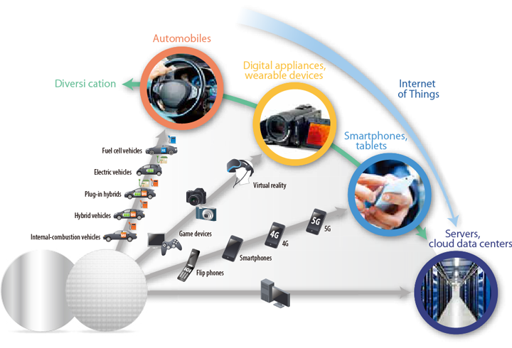
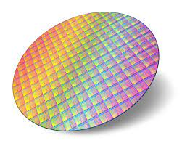
Introduction
Basis of Electronic Equipment
Silicon Wafers
Motivation (WHY?)
Problem ?
Related Work ?

Slide 3
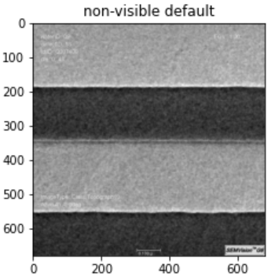
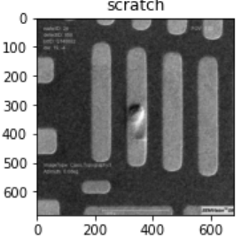
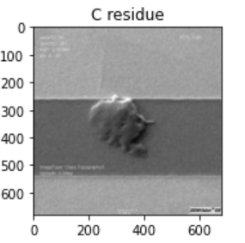
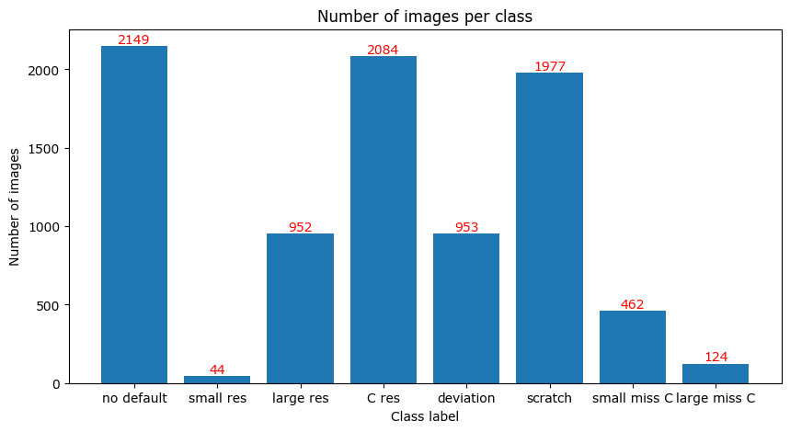
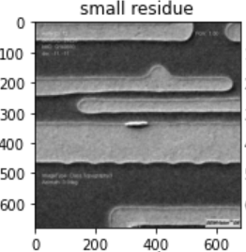
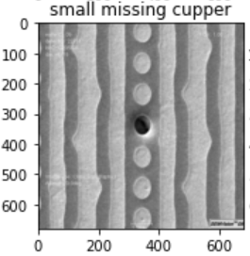
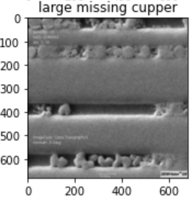
Data Exploration
Sample Images
Statistics
680 × 680 pixels
48 – 271 KO
Grayscale

Slide 4
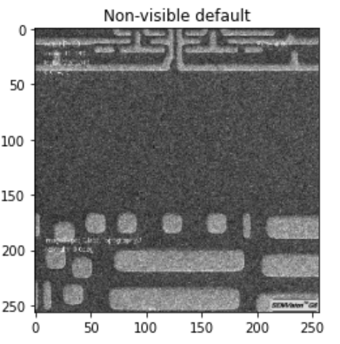
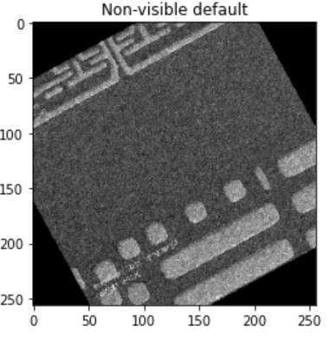
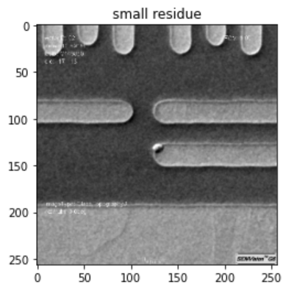
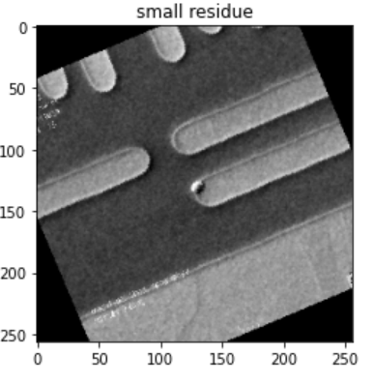
Data Preprocessing
Image Resizing
Image Normalization
Data Augmentation

Slide 5
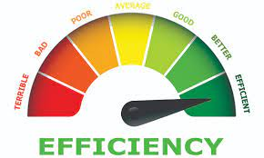
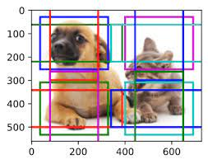

The Advantages of Using Inception Architecture
Efficient computation with Fast Training Time: A Key Advantage for Resource-Constrained Environments
Multi-scaled feature extraction: robust to variations in the size and appearance of the objects in the images
Simplicity and popularity : Google's Cloud Vision API and TensorFlow Object Detection API

Slide 6
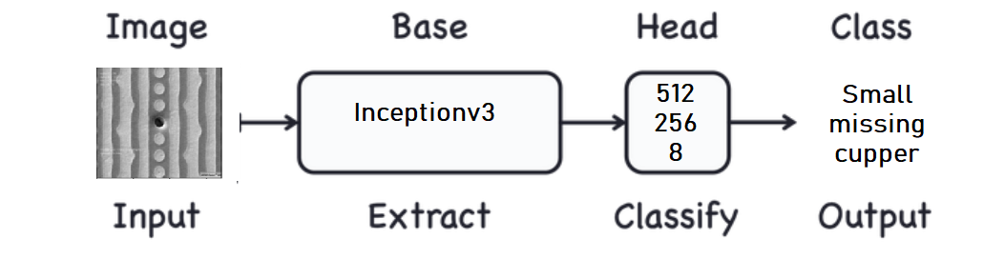
CNN Architecture

Slide 7
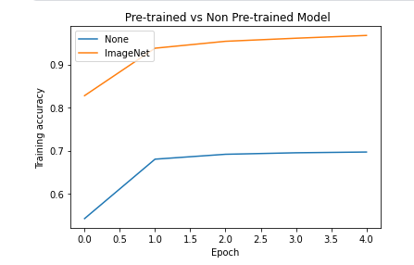
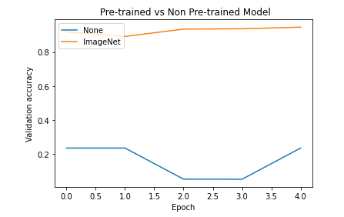
Training Progress: Pre-trained vs Non Pre-trained Weights
Huge difference !

Slide 8
Training parameters
Learning rate | Callbacks | Batch size | # of epochs | Optimizer | Loss | Val_acc
0.001 | LRscheduler | 64 | 3 | adam | CCE | 93.96%
0.001 | LRscheduler | 64 | 10 | adam | CCE | 96.72%
0.001 | LRscheduler | 64 | 20 | adam | CCE | 98.19%
good
better
best
We used ImageNet weights as a starting point for faster convergence !

Slide 9
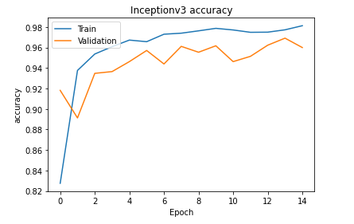
Model Performance over Training Epochs
Fast convergence !
Upward trend
No overfitting

Slide 10
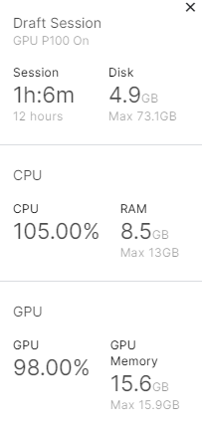
Experimental setup
DISK 73 GB
RAM 13GB
GPU P100 16 GB

Slide 11
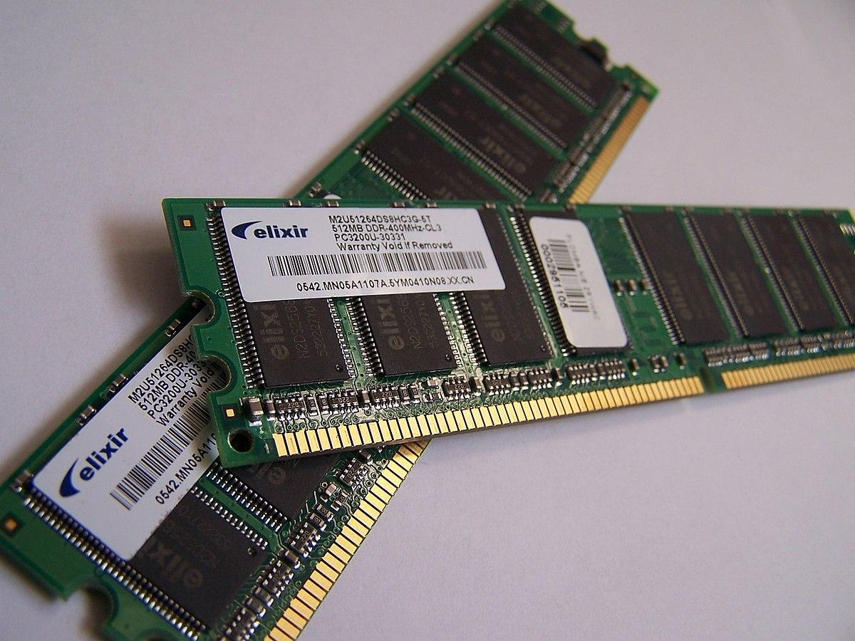
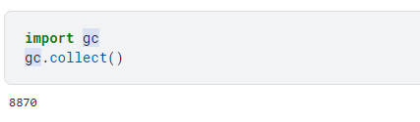
Challenges : Addressing Memory Limitations
Limited Available Memory ! We need more RAM!
Running manually python garbage collector

Slide 12
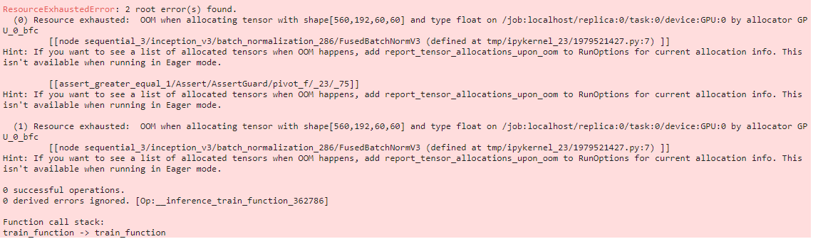

Overcoming Limited GPU Memory Resources
Not enough GPU memory
Smaller batches (64)
Low image resolution (256*256)
Smaller data type (float32)

Slide 13
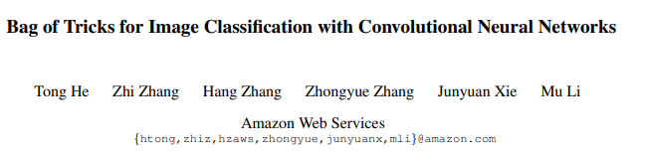
How did we deal with Overfitting?
Technique | Result
More Data Augmentation | Worked and gives best model
MixUp Data Generator | No improvements
CutMix Data Generator | Worked and gives best model
Label Smoothing and PCA noise | No improvements

Slide 14
Results
Kaggle private score : 0.98191 (3rd in the ranking)
Very fast : 69.24 ms for image prediction

